Slide 1
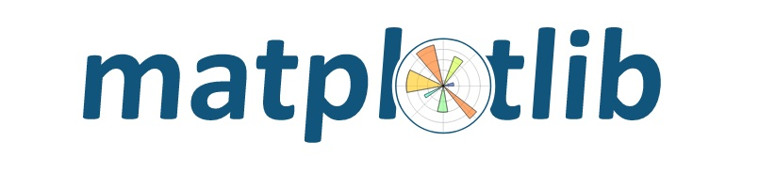




Specialization: Unsupervised Learning
Business Focus: Retail
Tool: Pandas, Matplotlib, Seaborn, Sklearn
Case Study: Customer Segmentation for UrbanCart Retail Chain
Project Learning Opportunities
Business Problem Understanding
Data Preprocessing and Cleaning
Understanding Clustering
Model Development and Evaluation
Interpreting Model Results
Actionable Business Insights
Tools and Technology to be Used

Slide 2


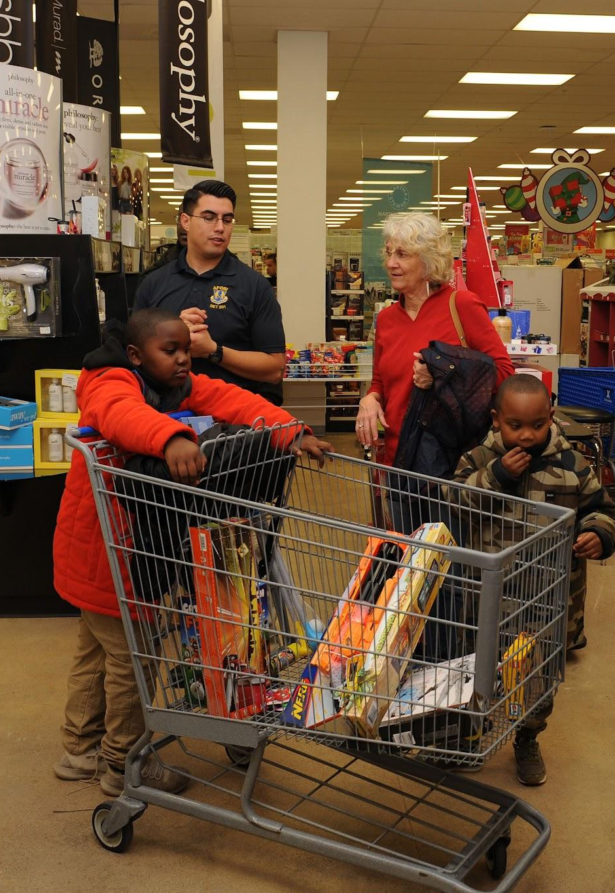

Background
UrbanCart Retail is a mid-sized retail chain operating across 50 locations in the United States. The company offers a wide variety of products, including groceries, clothing, and home essentials. While UrbanCart has a loyal customer base, it struggles to understand the diverse preferences and behaviors of its customers.
UrbanCart plans to use data-driven insights to personalize marketing campaigns, optimize inventory, and improve customer retention.
Mission: Mission: To deliver tailored shopping experiences by understanding and meeting the unique needs of every customer.
Vision: To be the leader in customer-centric retail through innovation and analytics.

Slide 3

Problem Statement
UrbanCart collects customer transaction data but has limited knowledge of how to utilize this information to improve their business strategies.
They need a way to segment their customers into meaningful groups based on purchasing behavior and demographic details.
The goal is to use clustering techniques to identify distinct customer segments.

Slide 4
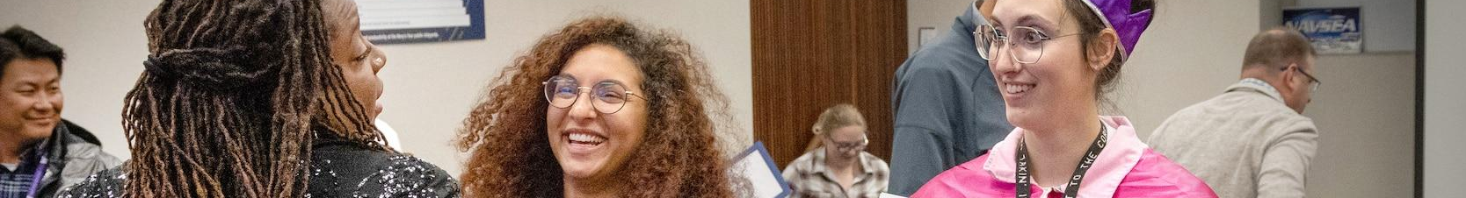
Rationale
Customer segmentation is a critical strategy for retail businesses to:
Enhance Marketing: Deliver personalized marketing campaigns to different customer groups.
Inventory Management: Stock products based on the preferences of specific customer segments.
Loyalty Programs: Develop tailored loyalty programs to improve retention.
By leveraging clustering techniques, UrbanCart aims to understand its customers better and improve operational efficiency.

Slide 5

Tasks
Data Understanding:
  Analyze customer transaction and demographic data.
  Identify relevant features for segmentation.
Data Preparation:
  Handle missing values and scale numerical features.
  Encode categorical features appropriately.
Model Development:
  Apply unsupervised learning techniques like K-Means to group customers.
  Determine the optimal number of clusters using methods like the Elbow Method or Silhouette Score.
Insights and Recommendations:
  Interpret the characteristics of each customer segment.
  Provide actionable recommendations for marketing, inventory, and loyalty programs.
Visualization:
  Create visualizations (e.g., cluster distributions) to present findings.

Slide 6
Data Dictionary
Feature | Description
CustomerID | Unique identifier for each customer.
Age | Age of the customer.
Gender | Gender of the customer (Male/Female).
AnnualIncome | Annual income of the customer in USD.
SpendingScore | Customer's spending behavior score (1–100, higher is better).
PurchaseFrequency | Average number of purchases made per month.
AverageBasketSize | Average transaction amount in USD.
LoyaltyPoints | Loyalty points accumulated by the customer.
PreferredCategory | Most frequently purchased product category (e.g., Groceries, Clothing).

Slide 7
Project Workflow
Data Preparation:
Clean the dataset, handling issues like missing values, duplicates, and outliers.
Encode categorical variables and scale numerical features.
STEP 1
Exploratory Data Analysis (EDA):
Perform univariate, bivariate, and multivariate analysis to uncover insights.
STEP 2
Model Development:
BApply unsupervised learning techniques like K-Means to group customers.
Determine the optimal number of clusters using methods like the Elbow Method or Silhouette Score.
STEP 3
Insights and Recommendations:
Interpret the characteristics of each customer segment.
Provide actionable recommendations for marketing, inventory, and loyalty programs.
STEP 4
STEP 5
Visualization:
Create visualizations (e.g., cluster distributions) to present findings.

Slide 8

READY TO
DELVE IN?

